Slide 1
HCI PROJECT SECOND DELIVERY
Rodrigo Euan
Ricardo Ku
Guillermo Medina
Fernando Rodríguez

Slide 2
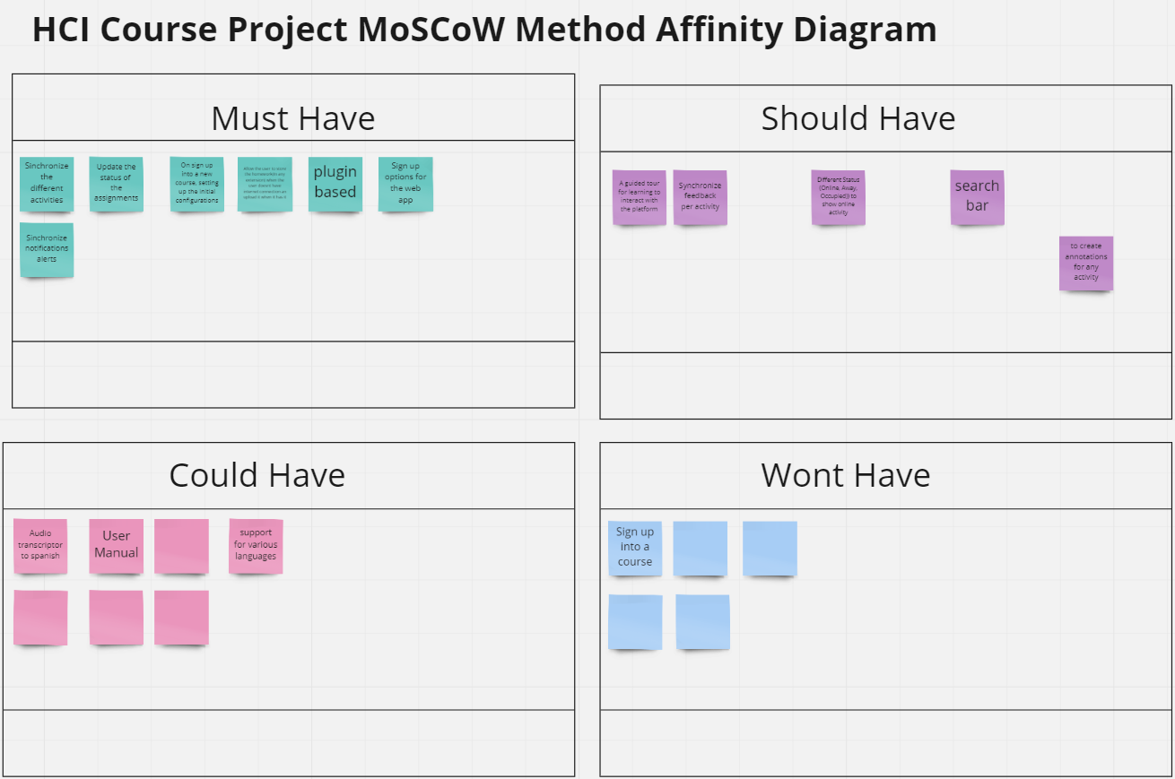
How it started
https://miro.com/app/board/o9J_lEb64_o=/

Slide 3
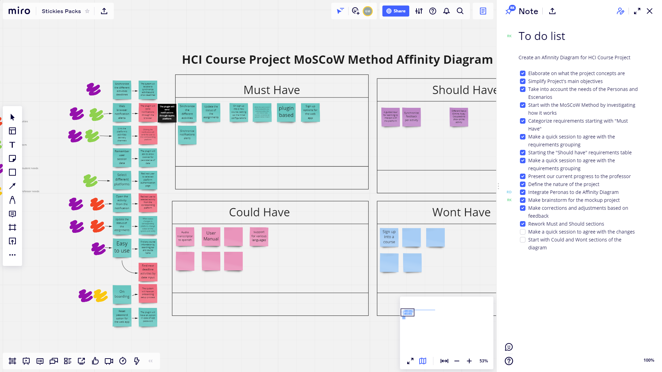

Slide 4
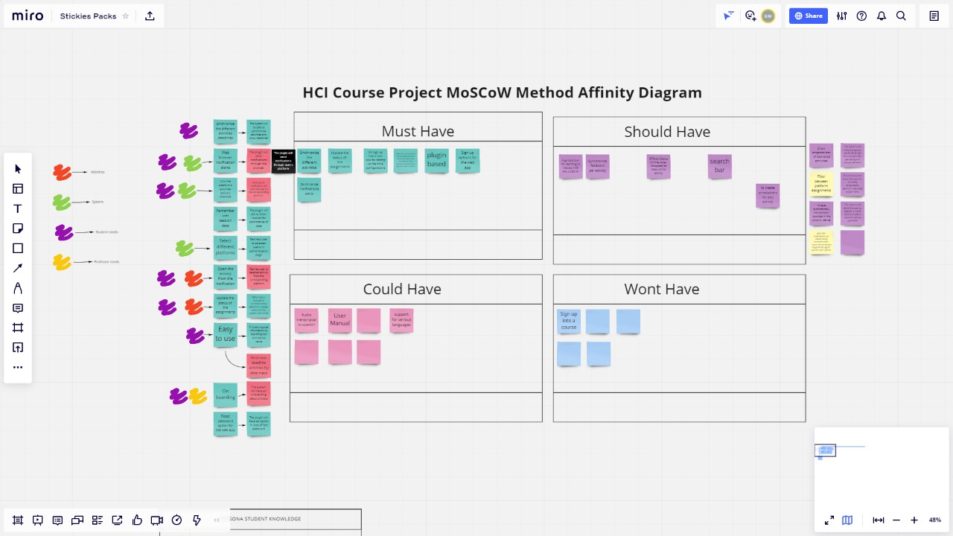

Slide 5
How our requirements evolved
We updated several requirements, being the most significant
Before | Updated
Users can find a course or an activity by several data related | The search bar will be able to find an activity and/or course by entering any related data
Users should be able to decide if they want to autosave each video session recorded | A user can enter to automatic preconfiguration settings and toggle a button to decide if autosaved video session must be allowed and link to a personal cloud account to store it

Slide 6
Traceability Matrix
Classification | Requirement | Refined requirement | Stakeholders | Metrics
Functional | The student should never disregard an activity, message from professor or update to scheduled delivery in any course | The plugin will send notifications through the browser at 99% of times when internet is available | System | Mean of number of events completed accurately
Easy of use | It should be easy for user to refer to its current notifications | Clicking the notification will send the user to the corresponding platform | Student, professor | Mean of number of events completed accurately
https://docs.google.com/spreadsheets/d/1IaObobQhed-cLKAZ4OU0s4UfHvKVZXb3T6lp04onptc/

Slide 7

https://docs.google.com/presentation/d/1Y0Jn8EJ_XDSGyxmFziap3lYIuSqZpPro4ba1Rwln3kY/edit#slide=id.p

Slide 8
Usability Requirements
Clicking the notification will send the user to the corresponding platform
The system will have a progress bar in which will be displayed the percentage of activity advance
The search bar will be able to find an activity and/or course by entering any related data

Slide 9
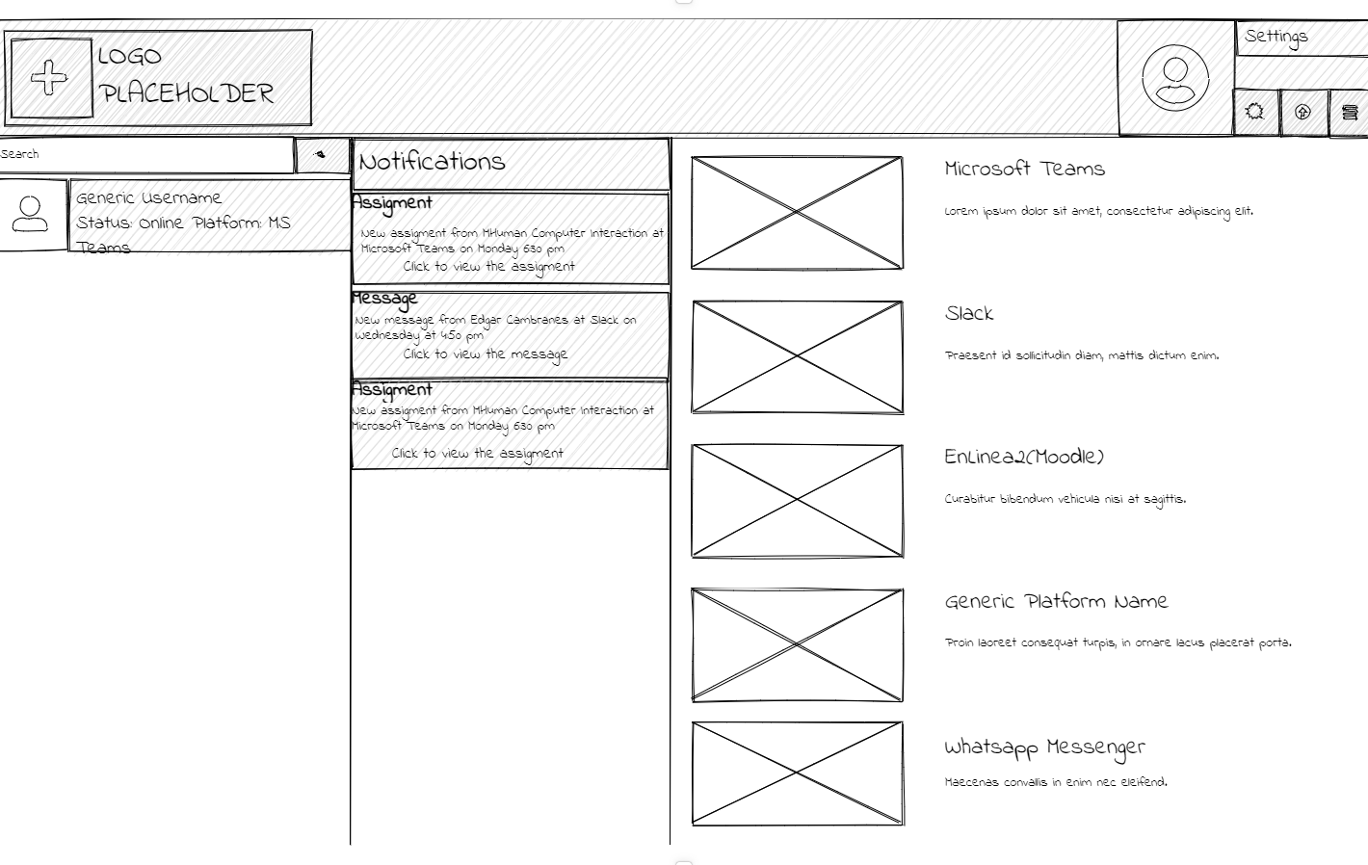
Low fidelity prototype
https://app.uizard.io/prototypes/pbymaYoKwWtR6OWPgavE

Slide 10
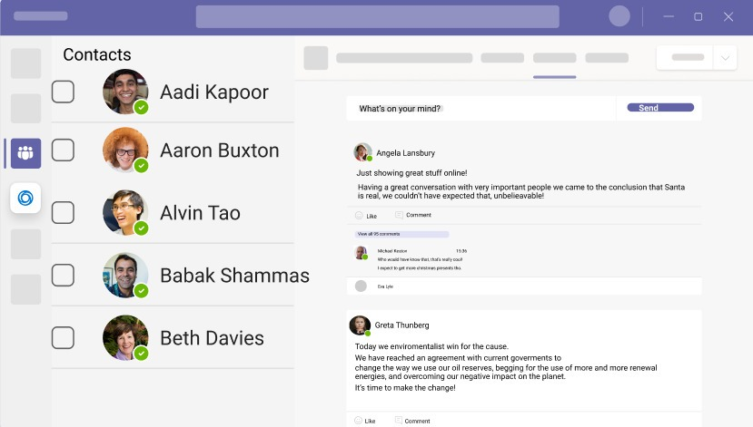
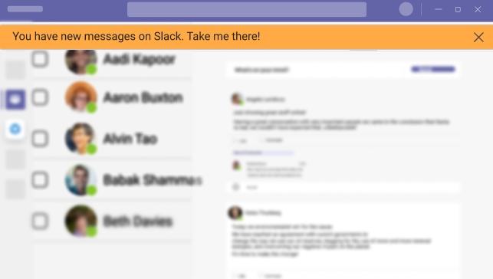
Requirements effect on interface
NFR: The system will display a pop up notification
“We are using a more friendly phrase to navigate to the corresponding notification platform, in this example we use “take me there” instead click here, this is because quality assurance standard setted up in 2001 by w3 org. We are adding a blur effect when notification pops up in order the user focus its attention only on the notification. This is technically possible according to microsoft apis.”¹
https://www.figma.com/file/3RvdD3SGSLnXhO63ZLB8bd/Microsoft-Teams-UI-Kit-(Community)?node-id=6150%3A146

Slide 11
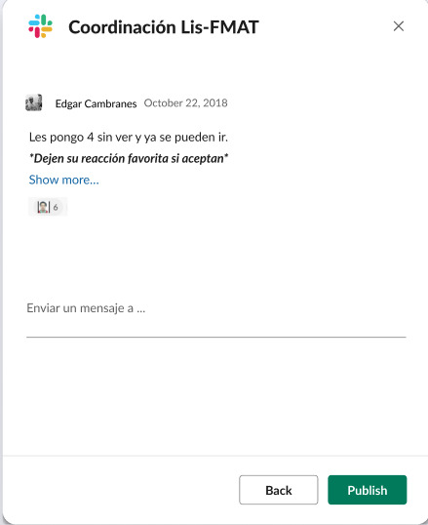
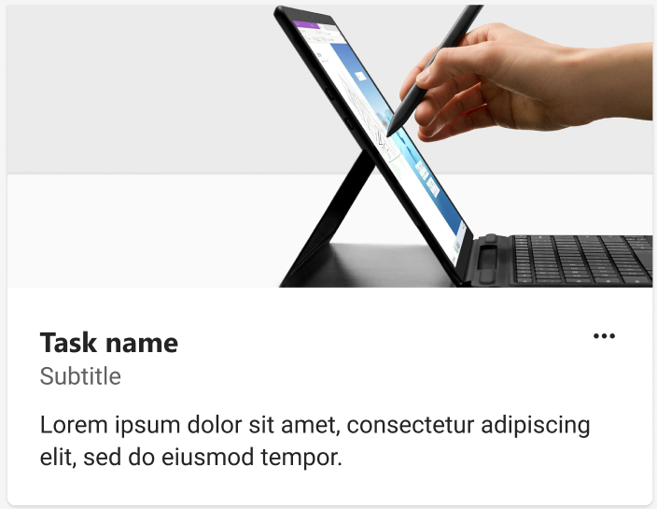
Requirements effect on interface
NFR: The system will redirect the user to selected platform.

Slide 12
Metrics and how to apply
Classes | Equivalents | Score(hrs)
B | B | 1
M | BB | 2
A | MM | MBB | BBBB | 4
https://drive.google.com/file/d/1dDHcBNqkAo7fWYBbOuZJJAksKsaBM-PU/view

Slide 13
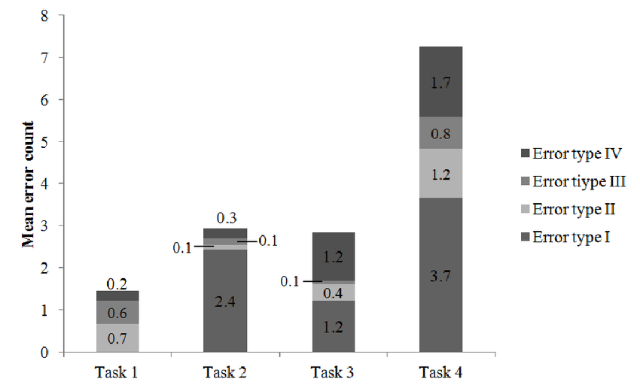
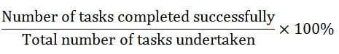

Usability Metrics
The ISO/IEC 9126-4 Metrics
https://docs.google.com/presentation/d/14Jz6mRMZUx0Jo2T2V8zGiusrupSfiWG1WjB8QTP-jVU

Slide 14
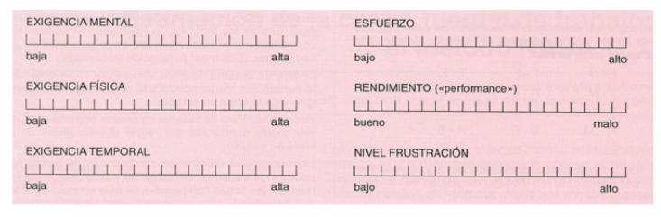
We choose the NASA’s task load index is a measure of mental effort

Slide 15



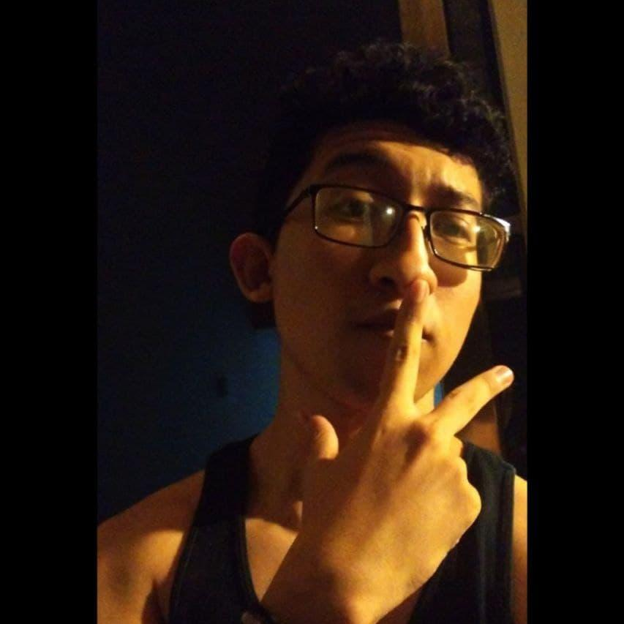
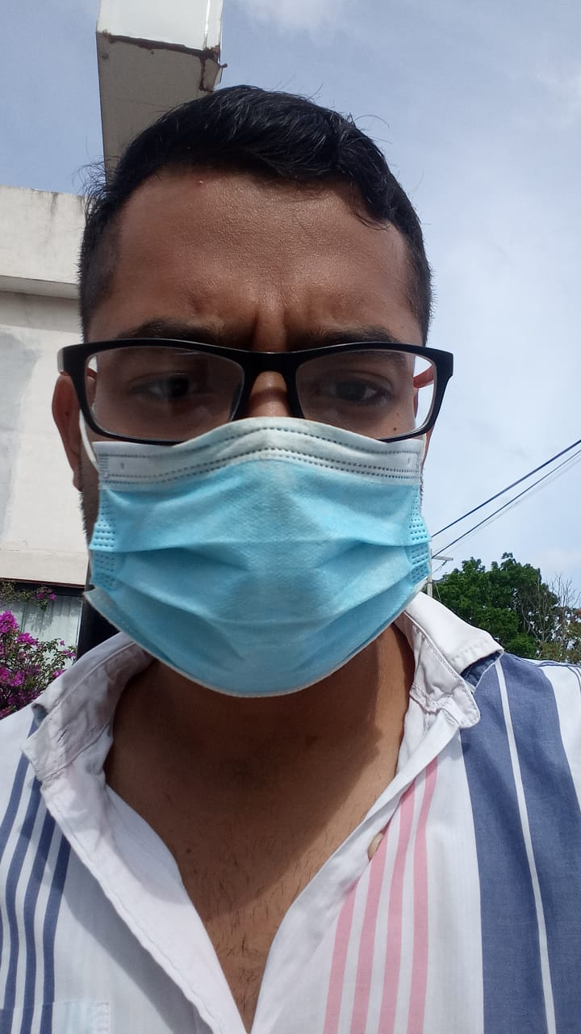

OUR TEAM
Ricardo Kú
Rodrigo Euan
Juan Fernando
Guillermo Medina

